Slide 1
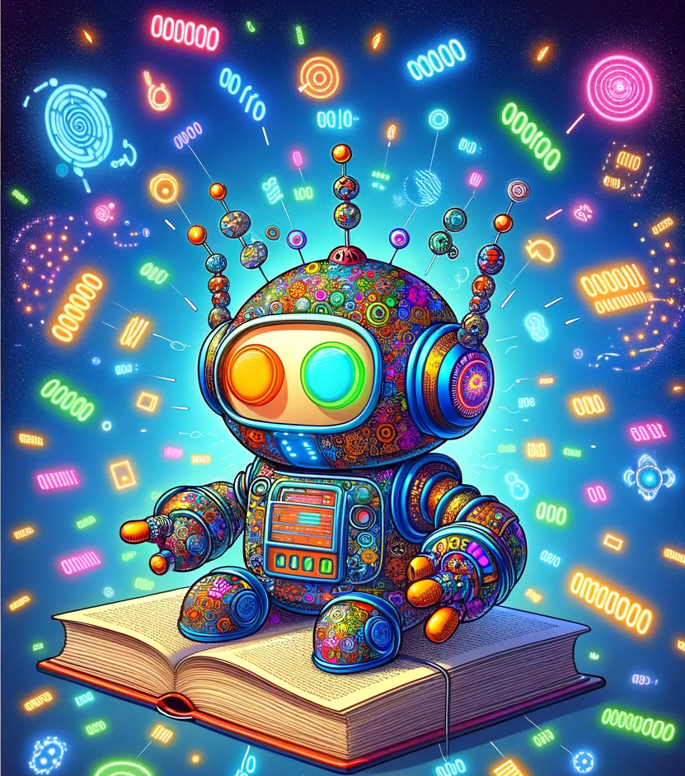
Automatic Annotation Tools
Brown Bag Lunch
Job Schepens & Fafa Same

Slide 2
Different types of annotation
Manual
Automatic
Hybrid (a combination of manual and automatic)
Crowdsourced

Slide 3
What can be annotated automatically? (1)
Tokenization: Segmenting text into tokens.
Part-of-Speech (POS) Tagging: Assigning parts of speech to each token.
Lemmatization: Reducing words to their base form.
Named Entity Recognition (NER): Classifying named entities into categories (persons, organizations, etc.).
Dependency and Constituency Parsing: Analyzing sentence structure.
Morphological Analysis: Analyzing word structures and components
Chunking (Shallow Parsing): Breaking up a sentence into syntactically correlated parts of words, like NPs, VPs, etc.

Slide 4
What can be annotated automatically? (2)
Coreference Resolution: Identifying when words refer to the same entity.
Semantic/thematic Role Labeling: Identifying the basic who-did-what-to-whom structure of a sentence.
Discourse Analysis: Analyzing text structure above the sentence level.
Word Sense Disambiguation: Determining which sense of a word is used in a sentence.
Phonetic and Prosodic Annotation: Analyzing the sound aspects of speech.
Sentiment Analysis: Determining the writer's attitude, e.g., positive, negative, or neutral.
Gesture Analysis: Examining the role and meaning of physical gestures in communication.

Slide 5
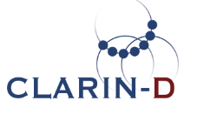
Automatic annotation solutions
Web Servies
Weblicht (link) segmentation, tokenization, lemmatization, POS tagging, parsing, etc
BAS Web service (link) phonetic analysis
UDPipe (link): dependency parsing
Different Libraries/models
R: tm (text mining), quanteda, tidytext, spacyr, tokenizers, udpipe
Python: spaCy, NLTK, StanfordNLP, AllenNLP, CoreNLP
Huggingface & OpenAI: Whisper, Pyannote, XLNet, BERT, RoBERTa, etc.

Slide 6


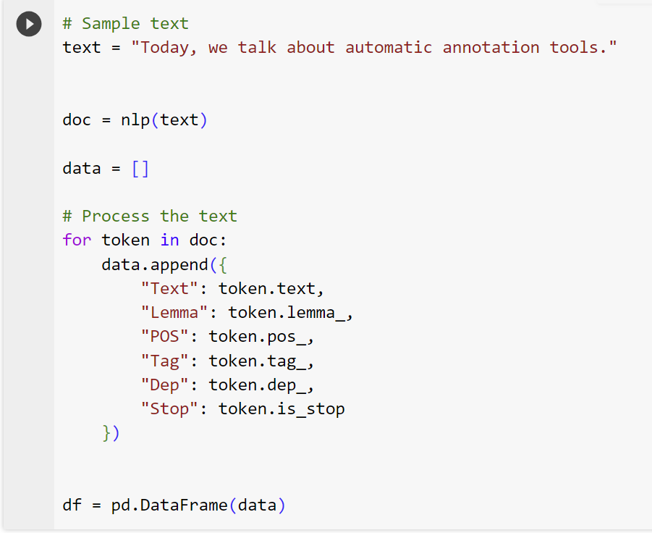
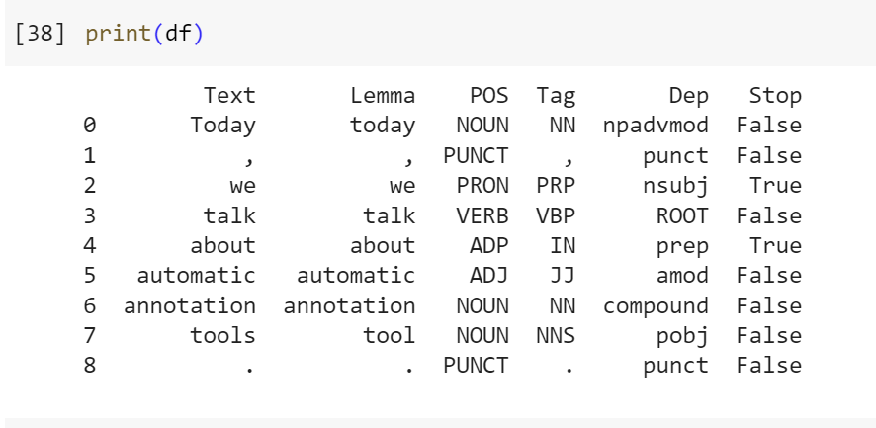
Basic NLP pipeline with spaCy

Slide 7
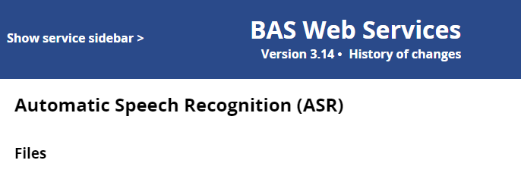
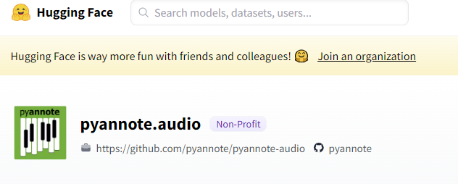
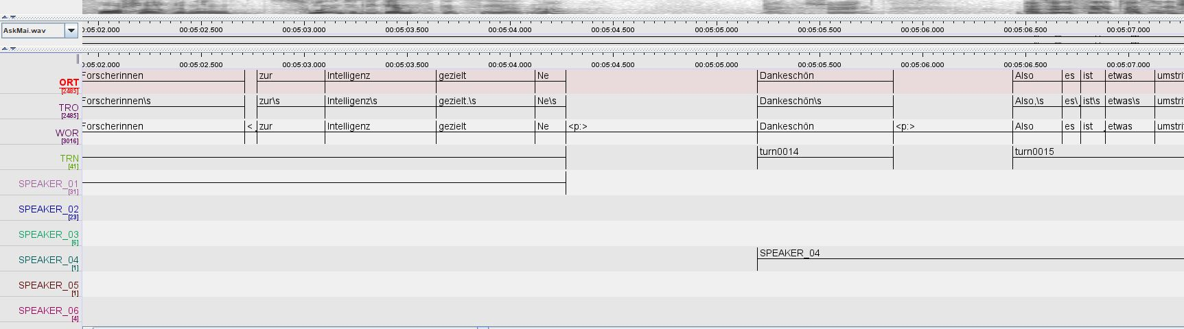
Automatic Transcription of German Conversations
Automatic Speech Recognition (ASR) [BAS Web Service, Fraunhofer]
Diarization: Pyannote [Python script]

Slide 8
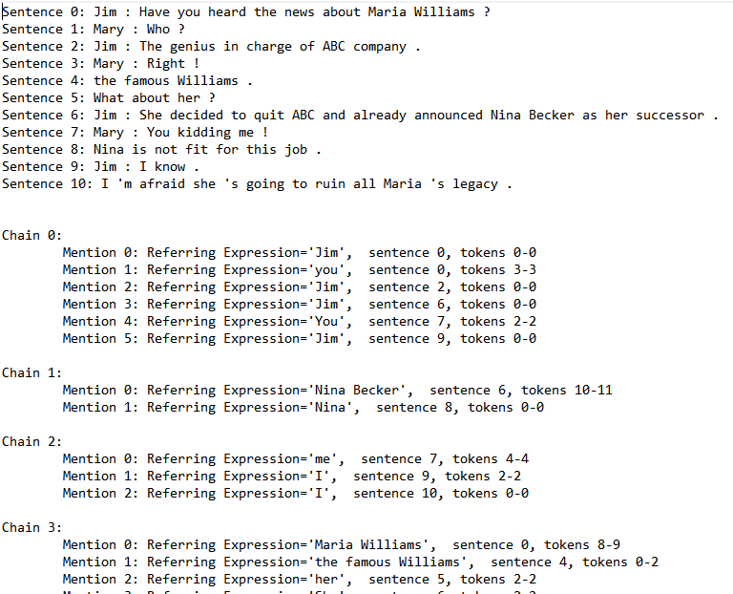
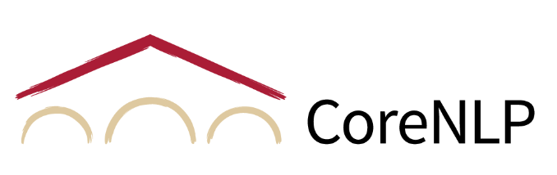
CoreNLP for Mention (RE) and chain detection

Slide 9
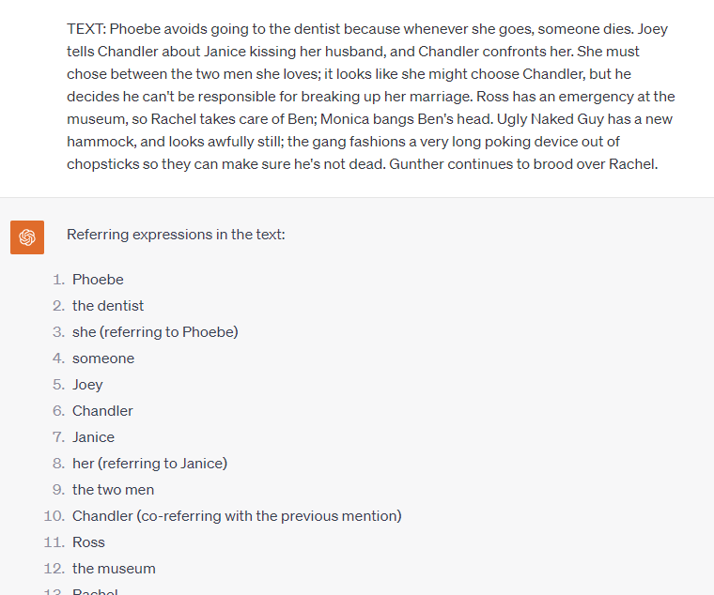
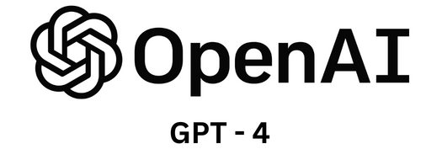
(Chat)GPT4 for Referring Expression Annotation
Check this link for the prompt given:
https://chat.openai.com/share/4e395e5a-ec3f-4489-92ee-058f42127e93

Slide 10
OpenAI Whisper + GPT API integration
Whisper
Transcript = 'Hier ist ein Beweis dafür, dass es auch gute deutsche Serien gibt. Da hätten wir zum einen Legal Affairs, das ist einfach wie das deutsche Suits, mega geil. ‚
Translate = 'Here's a proof that there are also good German series. There we have Legal Affairs, which is just like the German Suits. ‚
Further GPT integration
Word - Translation - Transcription: Hier - here - hɪr ist - is - ɪst ein - a - aɪn Beweis - proof - bəvaɪs dafür - for that - dafʏːɐ̯ dass - that - das es - it - ɛs auch - also - aʊx gute - good - ɡuːtə deutsche - German - dɔʏtʃə Serien - series - zeˈʁiːən gibt - there are - ɡɪpt

Slide 11
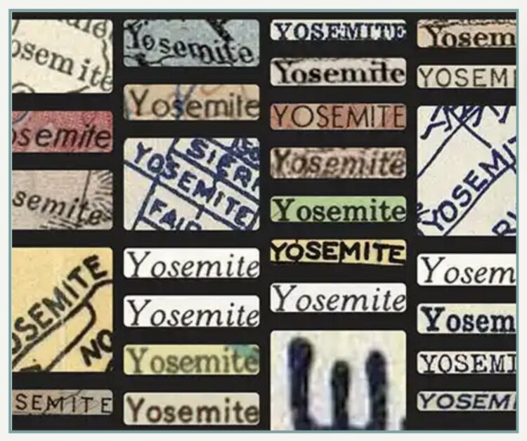
David Rumsey Map Collection
tens of thousands of historical maps from Stanford Digital Repository
search the collection by the text in the maps
machine learning tool called mapKurator
turns the text on maps into structured data

Slide 12
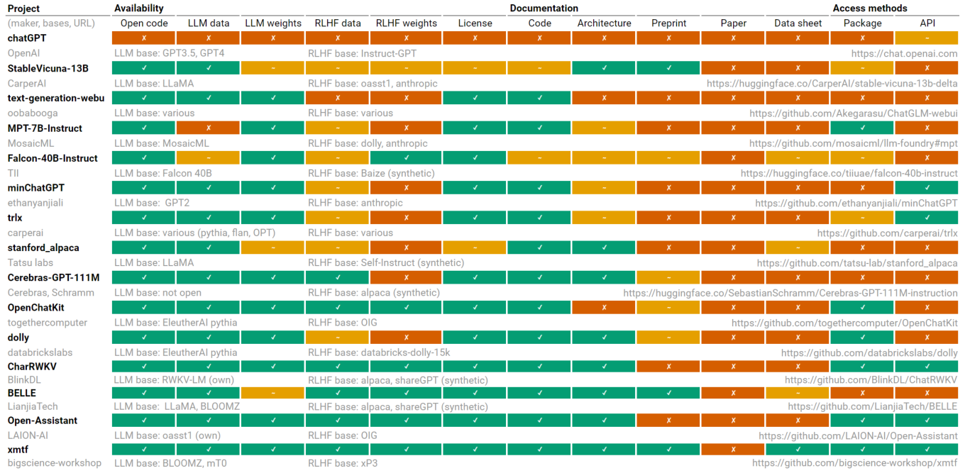
LLMs - Tracking instruction-tuned LLM openness.
(Liesenfeld et al., 2023)

Slide 13
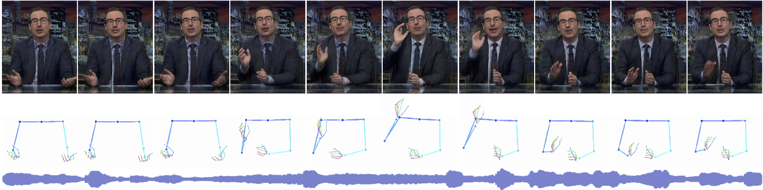
Predict gestures just from the sound of a voice
https://www.youtube.com/watch?v=h1JsRp3JriI
(Ginosar et al., 2019)

Slide 14
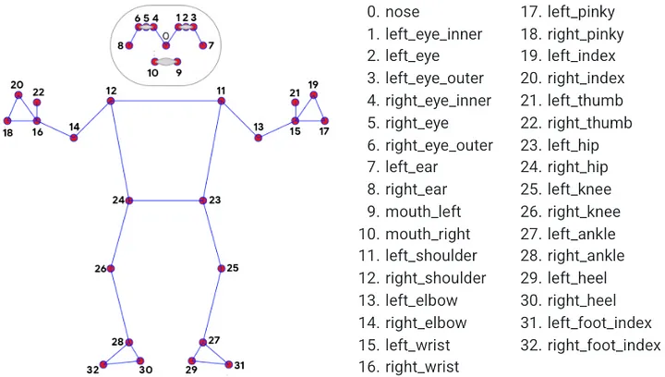
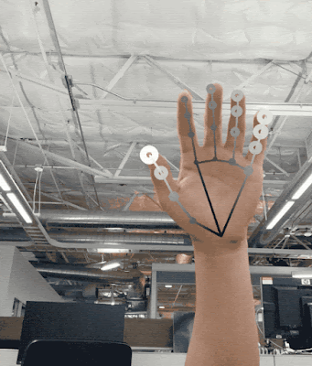
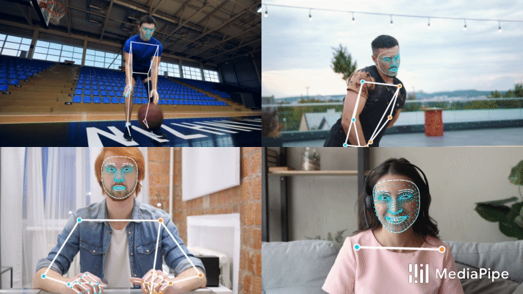
Mediapipe: from video to landmarks
https://blog.research.google/2020/12/mediapipe-holistic-simultaneous-face.html
https://blog.research.google/2019/08/on-device-real-time-hand-tracking-with.html

Slide 15
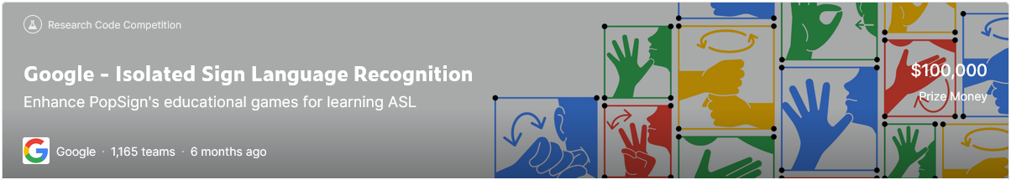
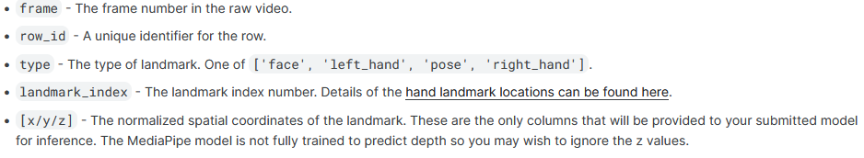
Machine learning: from landmarks to labels
Classify isolated American Sign Language (ASL) signs
Kaggle Competition
https://www.kaggle.com/competitions/asl-signs/overview
create a TensorFlow Lite model trained on labeled landmark data extracted using the MediaPipe Holistic Solution
help relatives of deaf children learn basic signs and communicate better with their loved ones

Slide 16
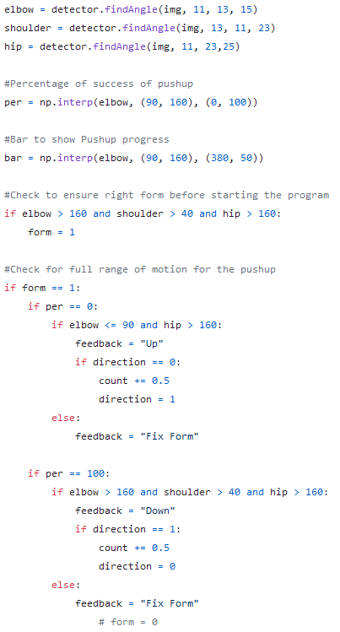
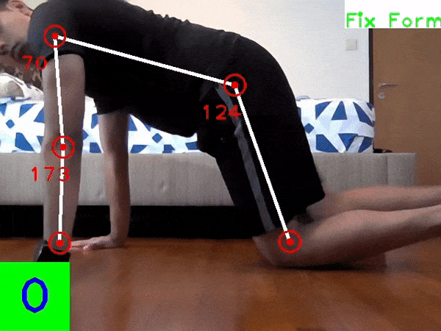
Python Programming with landmarks
tracking Push-ups
ensuring proper form for every repetition

Slide 17
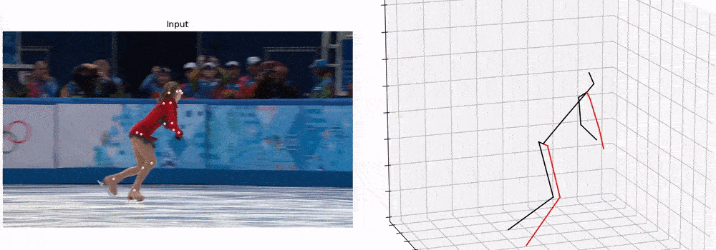
Facebook’s VideoPose3D
https://github.com/facebookresearch/VideoPose3D/blob/main/images/demo_yt.gif

Slide 18
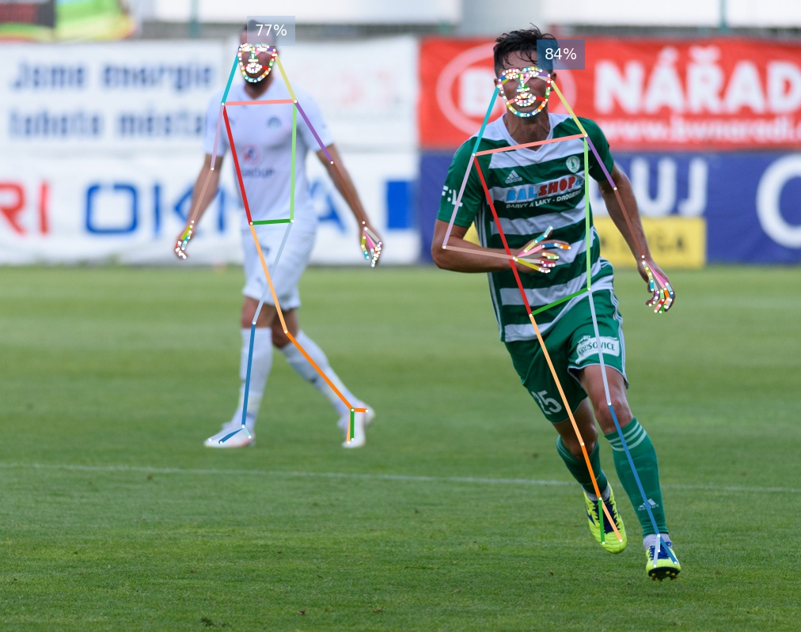
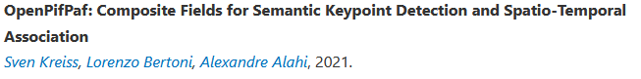
OpenPifPaf
https://openpifpaf.github.io/intro.html

Slide 19
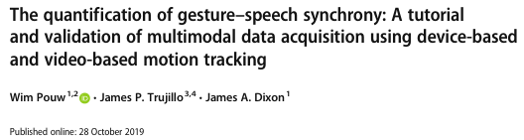
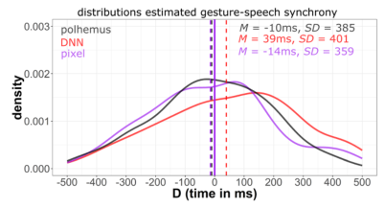
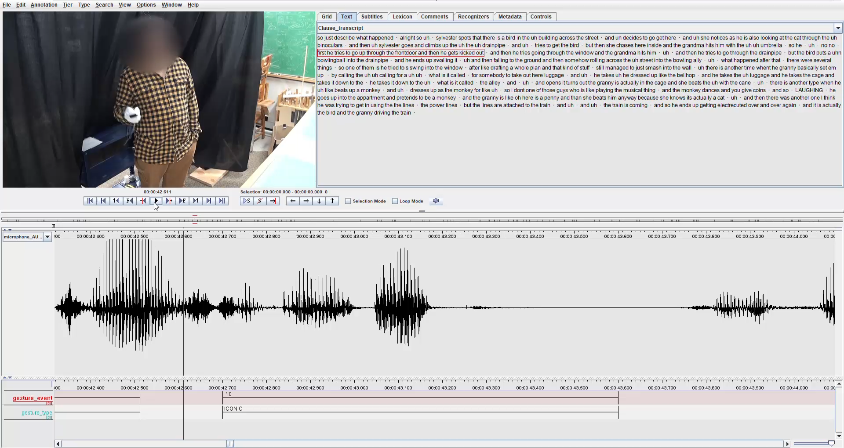
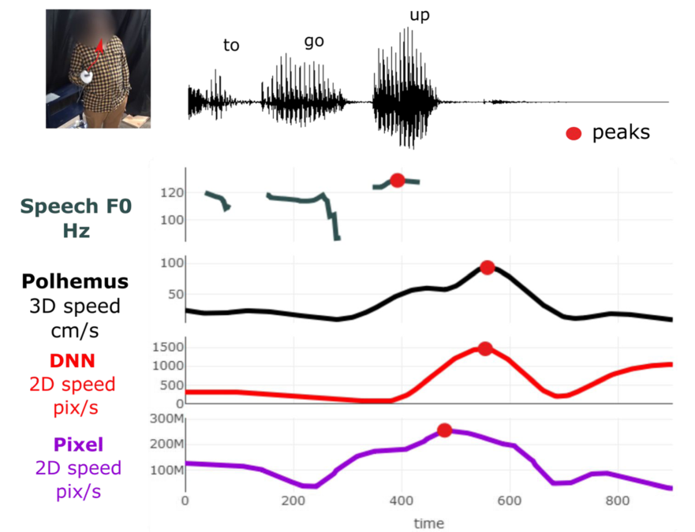
Examples - quantification of gesture–speech synchrony

Slide 20
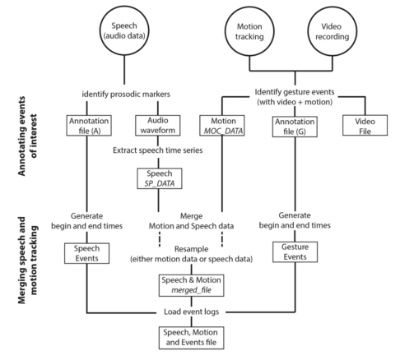
Summary: steps
Landmarks detection
Gold-standard: Motion tracker device
Automatic computer vision applied to video
Annotation
Manually in Elan
Deep-learning
(Pouw et al., 2020)

Slide 21
Summary: tools
OpenFace (github.com/cmusatyalab)
facial landmark detection, head pose estimation, facial action unit recognition, and eye-gaze estimation
OpenPose (github.com/CMU-Perceptual-Computing-Lab/openpose)
Real-time multi-person keypoint detection library for body, face, hands, and foot estimation
Mediapipe (github.com/google/mediapipe)
Cross-platform, customizable ML solutions for live and streaming media.
Secific solutions + framework
Deeplabcut, Many others

Slide 22
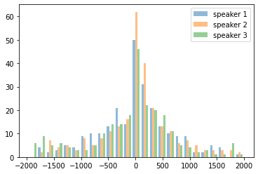
Learning
https://envisionbox.org/
For learners of multimodal social signal processing and analyses
Gesture networks
Dashboards
Full-body tracking
3D tracking from 2D videos
Pre-processing multiple data streams
Feature extraction
Turn-Taking Dynamics

Slide 23
Discussion points
Types of data for automatic annotation
Textual, audio, gesture
Difficulty level
Annotation from scratch or correction?
Feasibility & bottlenecks
Programming (python, R, etc.)
Data collection
Emerging field
Annotation quality: validity & reliability
Gold-standard corpora
Inter-annotator agreement
Hardware needs and financial costs
Important factors for quality
Video quality
Sample size
Open science
Availability (Code, data, model parameters, license)
Documentation (preprint, paper)
Accessibility
Ethical considerations & data protection
Masking tool based on Mediapipe (Owoyele et al., 2022)
Using OpenAI, Google products, etc.

Slide 24
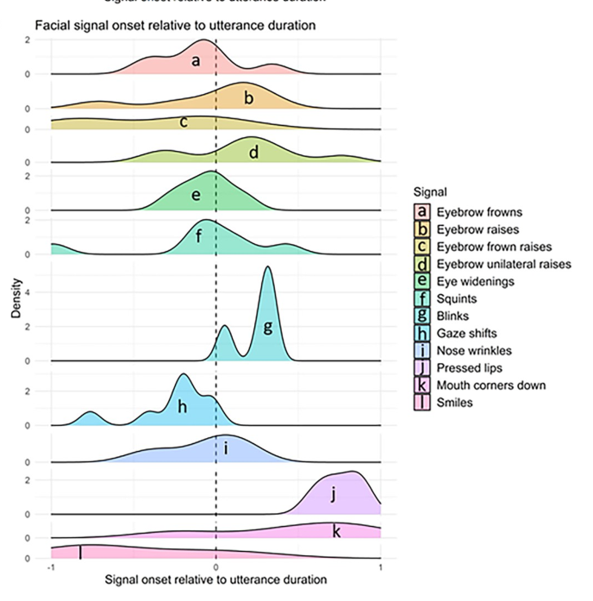
Manual annotation
Nota, N., Trujillo, J. P., & Holler, J. (2023). Specific facial signals associate with categories of social actions conveyed through questions. PLOS ONE, 18(7), e0288104. https://doi.org/10.1371/journal.pone.0288104

Slide 25
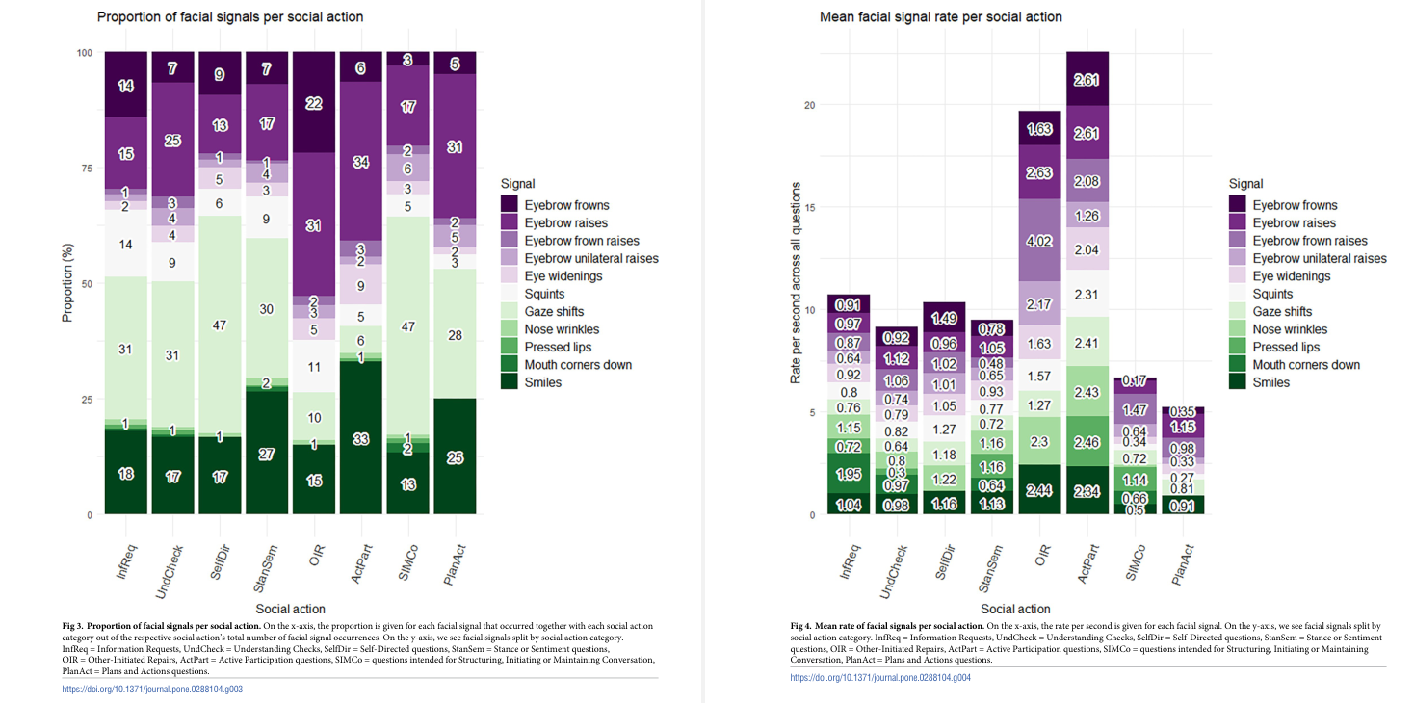
Nota et al. 2023

